Slide 1
Notes:
Static - locked

Slide 2

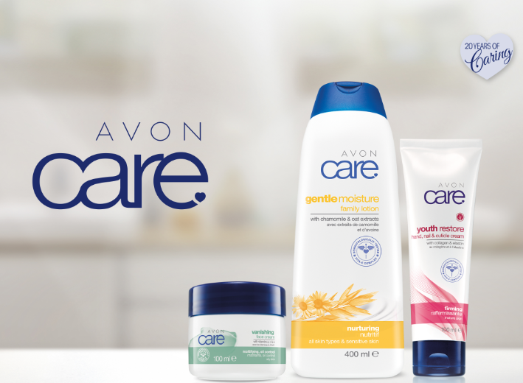

Training Guide

Slide 3

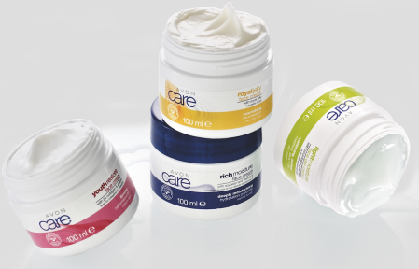

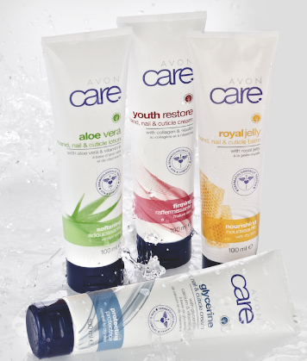

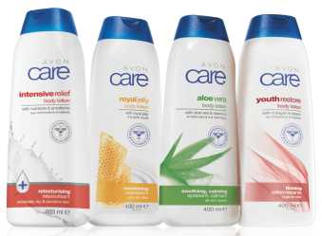
20 years of Avon Care
A Heritage Brand for you and your family #HugsofCare
For over 20 years, Avon Care’s deep, nourishing moisture has been caring for you and your family.
Avon Care makes every hug feel so much better, pampering you & your family with moisturising softness & freshness
An affordable entry level brand that has skin care products to suit different skin types!

Slide 4

3 Simple Selling Tips
How to sell Avon Care… easy as 1,2,3….
Measure the money
#1
How much money does she have to spend?
#2
Know the need!
What is her REAL Skincare concern?
#3
Counter the competitor
What competitor products is she using?

Slide 5

Selling Tip 1
How to sell Avon Care… easy as 1,2,3….
#1
Measure the money
How much money does she have to spend?
Avon Care is the BEST Entry level skincare brand
Price range is between R29 to R80

Slide 6

Selling Tip 2
How to sell Avon Care… easy as 1,2,3….
#2
Know the need!
What is her REAL Skincare concern?
Understanding your skin type and the Skin Type of customers opens the door into selling Skincare.
If you can help her identify her concerns and give her a skincare solution, you help her, and earn money for yourself

Slide 7

Different types of Skin Type
All Skin Types are different, it is important to understand what skin type you customer is in order to have a satisfied purchase
Uneven
Skin Tone
Oily Skin
Dry Skin
Ageing Skin
6 Questions to Ask
Main Skin Concern?
Appearance of Skin?
Pore Size?
How often does your skin break out?
Skin Texture?
Facial Surface Lines?

Slide 8
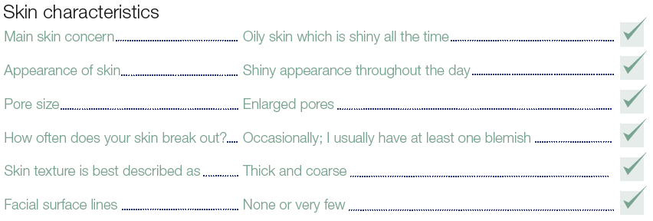
How Identify Skin Types
A customer with Oily skin will have the below characteristics
Oily Skin

Slide 9
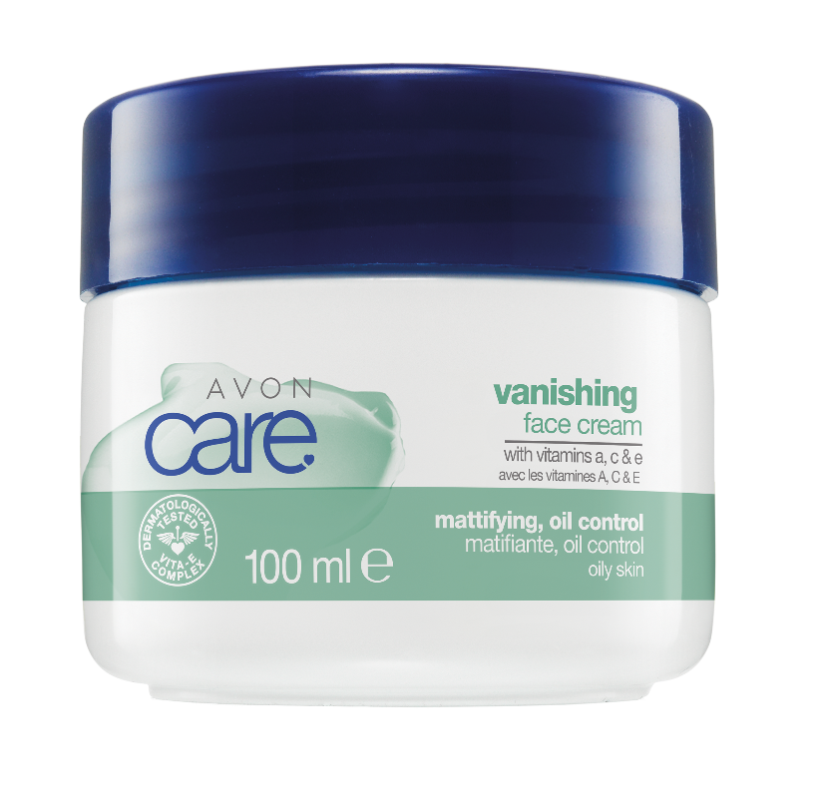
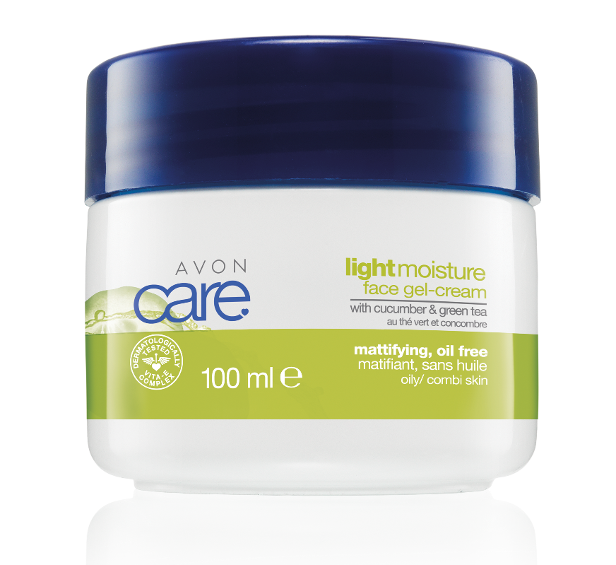
How Identify Skin Types
Products to match Oily Skin Type
Oily Skin
Bye Bye Oily Skin,
Hello Shine-free Skin!
#1 Avon Face Cream
  The formula mattifies the skin, providing all day oil & shine control
  The formula is lightweight, oil free and quick absorbing
VANISHING CREAM
LIGHT MOISTURE CREAM

Slide 10
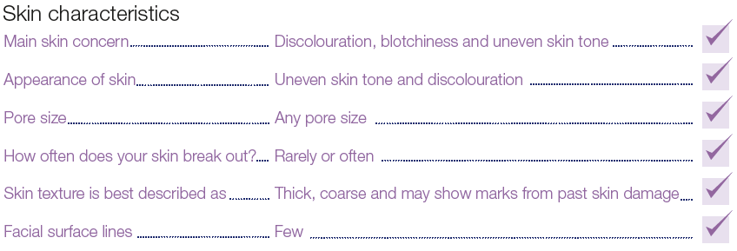
How Identify Skin Types
A customer with Uneven Skin will have the below characteristics
Uneven
Skin Tone

Slide 11
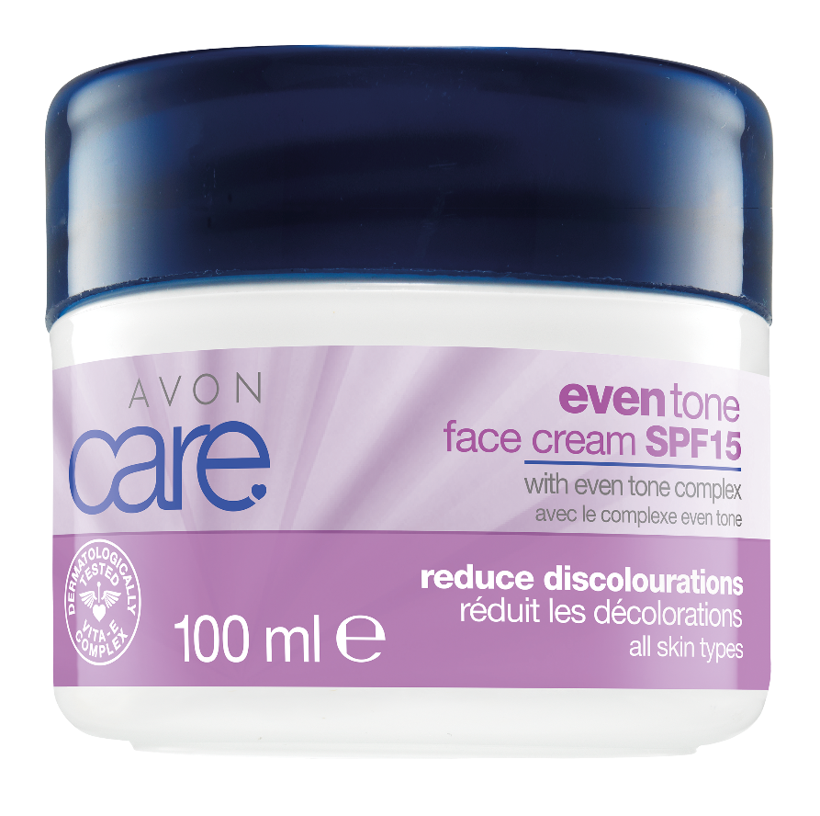
How Identify Skin Types
Products to match Uneven Skin Tone
Uneven
Skin Tone
Bye Bye Blemishes,
Hello Even Skin!
Formulated with Even Tone Complex* to:
  Reduce the appearance of blemishes
  Controls excess melanin production** which causes an uneven skin tone,
  Reduces appearance of dark spots & discolouration
Contains SPF 15 = protects skin against discouloration caused by the Sun

Slide 12
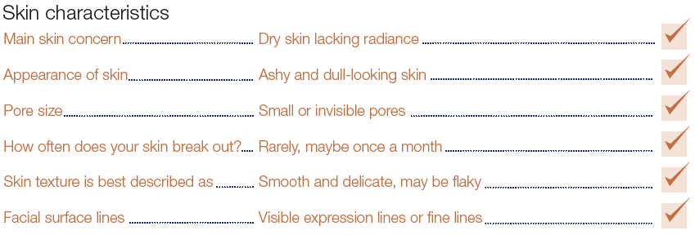
How Identify Skin Types
A customer with Dry Skin will have the below characteristics
Uneven
Skin Tone
Dry Skin

Slide 13
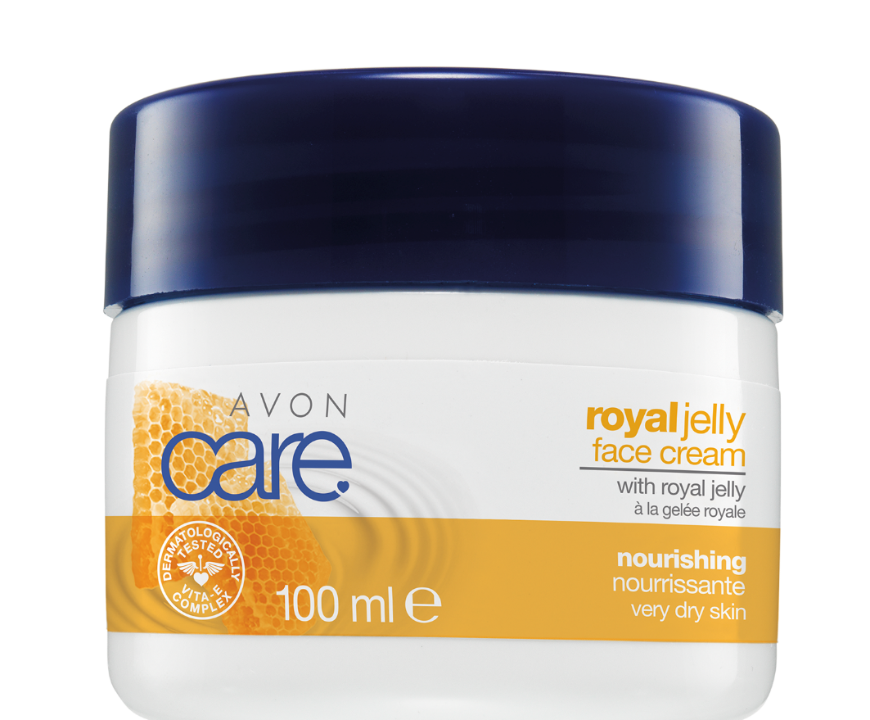
How Identify Skin Types
Products to match Dry Skin Tone
Dry Skin
Bye Bye Ashy Skin,
Hello Moisturised Skin!
Provides 2X Moisture
Non-Greasy!
Provides 25h Moisture
Formulated with softening & restoring royal jelly and vitamin E

Slide 14
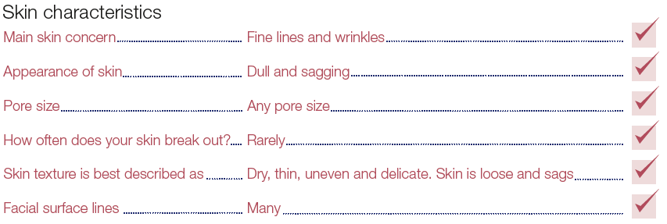
How Identify Skin Types
A customer with Ageing Skin will have the below characteristics
Uneven
Skin Tone
Ageing Skin
Dry Skin

Slide 15
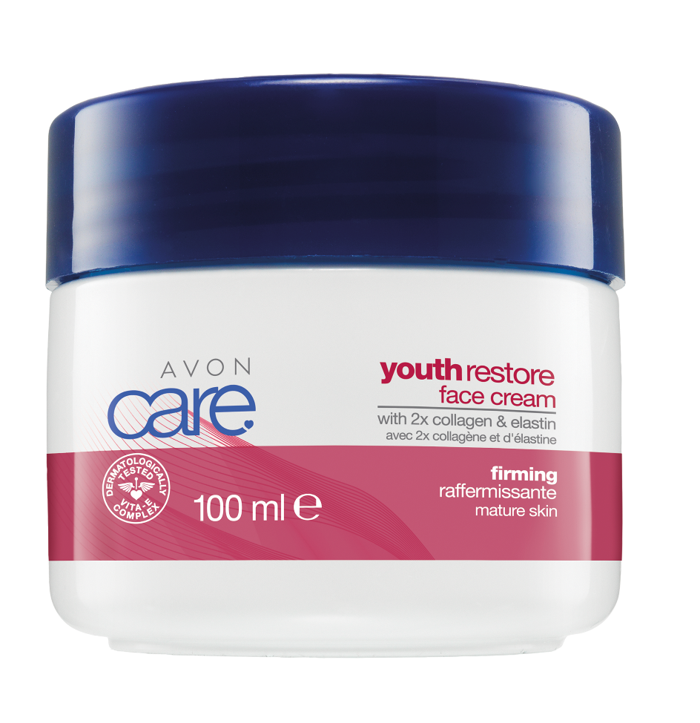
How Identify Skin Types
Products to match Dry Skin Type
Ageing Skin
Bye Bye Sagging Skin,
Hello Frim Skin!
Minimises the appearance of lines & wrinkles
Leaves skin looking & feeling younger
Helps reduce the appearance of age spots
Formulated 2X the collagen & elastin
What is Collagen?
Collagen is a protein found in the skin that gives it strength, support & flexibility
What is Elastin?
Elastin is a protein that coils & recoils like a spring, accounting for the elasticity of the skin
  Elastin provides elasticity
  Whilst Collagen provides support

Slide 16
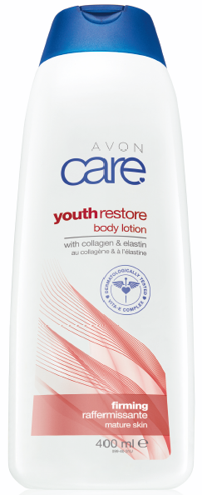
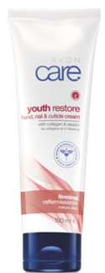
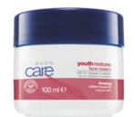
Selling across a Range is easy…
Making more commission ☺
Uneven
Skin Tone
FIRM SKIN
Dry Skin
FIRMING
BODY LOTION

Slide 17

Selling Tip 3
#3
Counter the competitor
What competitor products is she using?
There is no need unmet in Avon Care!
Let your customer tell you their skin condition & you will have a product to match!

Slide 18

Remember …
It is easy as 1,2,3….
Measure the money
#1
How much money does she have to spend?
#2
Know the need!
What is her REAL Skincare concern?
#3
Counter the competitor
What competitor products is she using?

Slide 19
The more you LEARN
The more you EARN
Success Made Easy
With

